Slide 1
The federal education future: Challenges and Opportunities
Summer 2017
Special Education Directors’ Leadership Academy
Katharine G. Shepherd, Ed.D.
University of Vermont

Slide 2
Agenda
Overview of ESSA
Comparisons of ESSA and NCLB
Opportunities and Challenges within ESSA
ESSA and Leadership and You
Leaders as policy implementers and change agents
Leaders as advocates
Lessons for Living in Interesting Times

Slide 3
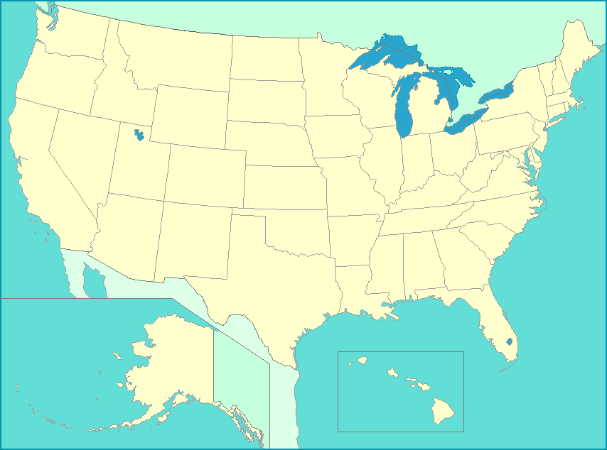
Living in Interesting Times…

Slide 4
Quiz!
“The ___________________ was designed to stimulate innovation, to strengthen the states, to link research with the schools and to make the problems of the poor the nation’s number one priority.”
Jerome T. Murphy
Elementary and Secondary Education Act, 1965
No Child Left Behind Act, 2001
Every Student Succeeds Act, 2015

Slide 5
Elementary and Secondary Education Act (ESEA) Brief History
The Elementary and Secondary Education Act (ESEA, 1965)
Focused on civil rights and poverty
NCLB 2001 (PL 107-110): Reauthorization of ESEA
Focused on accountability: (prior to NCLB: only 9 states required testing in ELA for students in grades 3 – 8, and only 7 required testing in math)
Spurred national conversations on education improvement

Slide 6
ESSA: A FOCUS ON EQUITY AND QUALITY
Purpose of ESSA:
“To provide all children significant opportunity to receive a fair, equitable, and high quality education, and to close educational achievement gaps.

Slide 7
Champions and Critics of NCLB
Thumbs-up | Thumbs-down
Mandated a focus on underperforming groups of students | “Heavy footprint” of federal government
Created more consistency re: state accountability | Too much emphasis on standardized testing
Focused on teacher quality through “highly qualified” provision | Narrow definition of quality
ESEA waivers designed to increase flexibility | Controversial approaches to evaluating teachers

Slide 8
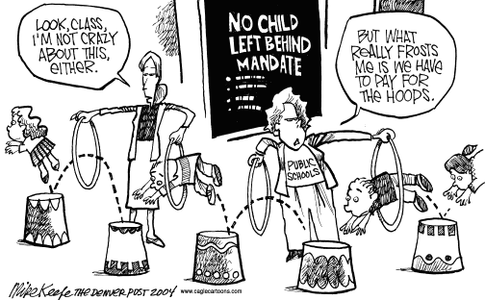
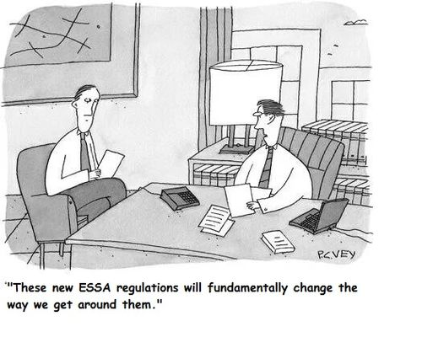

Slide 9
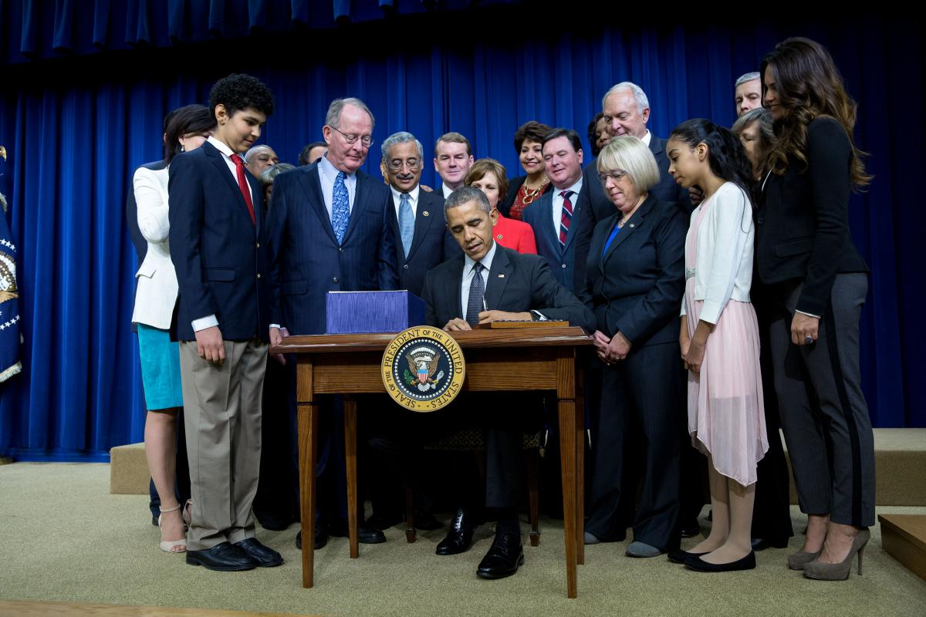
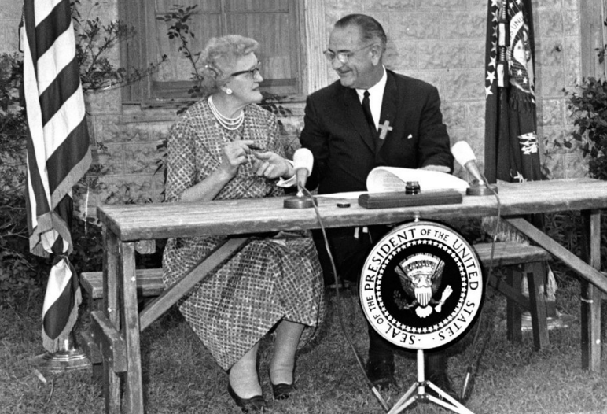
President Johnson signs the ESEA into law April 11, 1965 with his childhood teacher, Kate Deadrich Loney
President Obama signs the Every Student Succeeds Act into law on December 10, 2015
Notes:
Patrick insisted on this!

Slide 10
Timeline of the Every Student Succeeds Act (ESSA)
Passed with bipartisan support: Resolved differences between H.R. 5, the Student Success Act, and S. 1177, the Every Child Achieves Act
President Obama signed December 10, 2015 (PL 114-95)
Regulations issued November 29, 2016; some rescinded February, 2017
State plans required by May 3, 2017 or September 18, 2017
Colorado one of the first 17 to submit (May 3, 2017)

Slide 11
Key Components of ESSA
Major transfer of authority from federal government to states
Requires each State Education Agency (SEA) to develop a plan reflecting substantial input from the state’s governor, legislature, state board of education and other entities (LEAs, teachers and principals, parents, Indian tribes, and others)
Top lobbying priority during reauthorization
Plans must coordinate with other key federal initiatives, including IDEA, Rehabilitation Act, Perkins Career and Technical Education Act, Education Sciences Reform Act, NAEP, McKinnney-Vento, Family Literacy Act and others
Plans must be approved by U.S. Department of Education

Slide 12
Key Components of ESSA, Continued
Identification of comprehensive system of standards (college and career-ready)
Continued requirements for annual assessments of all students in grades 3 – 8 and once in HS
Requirement for additional assessment of school quality; more flexibility in assessment design
More state ownership in goal setting
States determine how teacher quality is determined
Multiple restrictions on Secretary of Education

Slide 13
Comparison of NCLB and ESSA
Key Areas of Difference:
State vs. Federal Authority
Annual Testing
Academic Standards
Accountability Systems
Teacher Quality
School “Report Cards”
Struggling Students and Schools

Slide 14
NCLB and ESSA: Federal v. State Authority
NCLB | ESSA
Federal government set goals and prescribed a framework for states | Transfer of authority to states
Universal goal: 100% proficiency in reading and math by 2014 AYP requirement for all students and subgroups | Eliminates 100% proficiency and AYP requirements States set their own “ambitious goals” within the ESSA framework
 | Secretary prohibited from prescribing any aspect of the accountability system

Slide 15
NCLB and ESSA: Annual Assessments
NCLB | ESSA
Annual testing in reading and math, grades 3 – 8, plus once in high school. Science testing once in grades 3-5, 6-8, and high school. | Same requirements, but must involve multiple measures of achievement, including those assessing higher order thinking skills, portfolios, etc.
Allowed reasonable accommodations for students with disabilities. Alternate testing allowed, but only for 1% of total number being assessed. | Maintains reasonable accommodations require-ments. Alt testing allowed for 1% of students, w/ most significant cognitive disabilities. Parents must be notified of alternate testing within IEP process.
Required states to administer testing to min 95% of students and 95% of each student subgroup. | Maintains requirement for testing 95% of students. Allows states to establish own laws for “opt-outs.”
States used their own tests | Districts may use national tests for high school students (e.g., SAT or ACT), with state permission
 | States may limit the aggregate amount of time students spend in testing
 | Prohibits Secretary specifying any assessment aspect
 | Assessments must be developed, to the extent practicable, using UDL. States may choose to design and use computer-adapted assessments.

Slide 16
NCLB and ESSA: Academic Standards
NCLB | ESSA
States required to adopt “challenging standards” in reading, math and science | Same, but Secretary barred from influencing states re: adopting a particular set of standards (e.g., Common Core). May also adopt standards in other areas. Standards must be aligned with entrance requirements for credit-bearing coursework in state’s higher education system
States must apply same standards to all schools and children. | Allows states to develop alternate academic achievement standards for students with most significant cognitive disabilities. Alternate achievement standards must be aligned with the state’s challenging academic standards, must reflect highest standards possible, and must ensure that a student meeting these standards is on-track for postsecondary education or employment.

Slide 17
NCLB and ESSA: Accountability systems
NCLB | ESSA
Focus on academic achievement only (reading, math, science); AYP requirement | State developed accountability systems must: Be based on challenging academic standards Establish ambitious long-term goals for all students and each subgroup Include required indicators: Academic achievement on annual assessments Add’l measure of academic achievement (K-8) English-language proficiency (gr. 3 – 8, HS) High school graduation rates and: One additional school-quality factor, such as: Access to and completion of advanced coursework School climate and safety Social-emotional learning Student engagement Attendance

Slide 18
NCLB and ESSA: Accountability systems
NCLB | ESSA
Establishment of subgroups for data disaggregation (SWD, major racial and ethnic groups, ELL, economically disadvantaged groups) | Same subgroups, with additional groups identified for data reporting: homeless status, students with parents in the military, students in foster care
 | States must adopt ambitious long-term goals with measures of interim progress for all students, as well as separately for each sub-group. Long-term goals must be established for academic achievement and HS graduate rates.
 | ESSA adds language around diplomas: SWDs who have participated in alternate assessment systems and receive an alternate diploma can be counted in state’s cohort graduation rate if the alternate diploma is standards-based, aligned with regular standards, and obtained within time period that state defines for FAPE.

Slide 19
NCLB and ESSA: Teacher Quality
NCLB | ESSA
Specific federal requirements regarding “highly qualified teachers” (bachelor’s degree, state certification, content knowledge) | No more “highly qualified” provision State plans must define “ineffective teachers,” “out-of-field,” and “inexperienced teachers”
Federal oversight regarding determination of teacher effectiveness. Federal waivers required multiple measures of teacher performance, including student growth on state assessments | Increased flexibility in use of Title II funds. New 3% optional set-aside may be used to strengthen school leadership. Prohibits U.S. secretary of education from prescribing specific measures of teachers, principals or other school leaders
 | Plans must address how LEAs will identify and address disparities resulting in low income and minority students being taught by ineffective teachers

Slide 20
NCLB & ESSA: State / School District Reporting
NCLB | ESSA
Schools required to publicly report (annually) disaggregated achievement data by subgroup; % of students not tested, graduation rates, information on teacher quality, other as determined by state. | Annual state report card still required; includes previous requirements as well as description of state accountability system, schools in need of improvement, number and % of students taking alternate assessments, NAEP data, postsecondary enrollment, civil rights data.
Requirement for reporting by subgroups (e.g., SWD, major racial and ethnic groups, ELL, economically disadvantaged groups) | Same requirements for subgroup reporting. If state identifies a school or subgroup as struggling, parents must be notified. SEA may allow LEAs to offer transfers to parents of students in identified schools.

Slide 21
NCLB & ESSA: Struggling Students & Schools
NCLB | ESSA
Federal government mandated corrective action for schools failing to meet AYP in consecutive years | Requires reporting on states and school districts requiring “comprehensive support and improvement”: Lowest performing 5% of Title I schools HS with high drop-out rates (1/3 or more) Have 1 or more specific subgroup of students that are struggling “Targeted support and improvement” developed for schools with one or more consistently underperforming subgroups. Locally developed Improvement plan must be approved by SEA, include evidenced-based strategies, identify resource inequities. SEA must develop exit criteria; after 4 years, may take more rigorous action. Eliminates School Improvement Grant Program but requires state to reserve 7% of Title 1-A funds for school improvement

Slide 22
What are the Issues? Challenges and Opportunities within ESSA
Enhanced role of states
Equity
School quality and accountability
Enhanced and flexible assessment
New definitions of teacher quality
Opportunities for workforce development

Slide 23
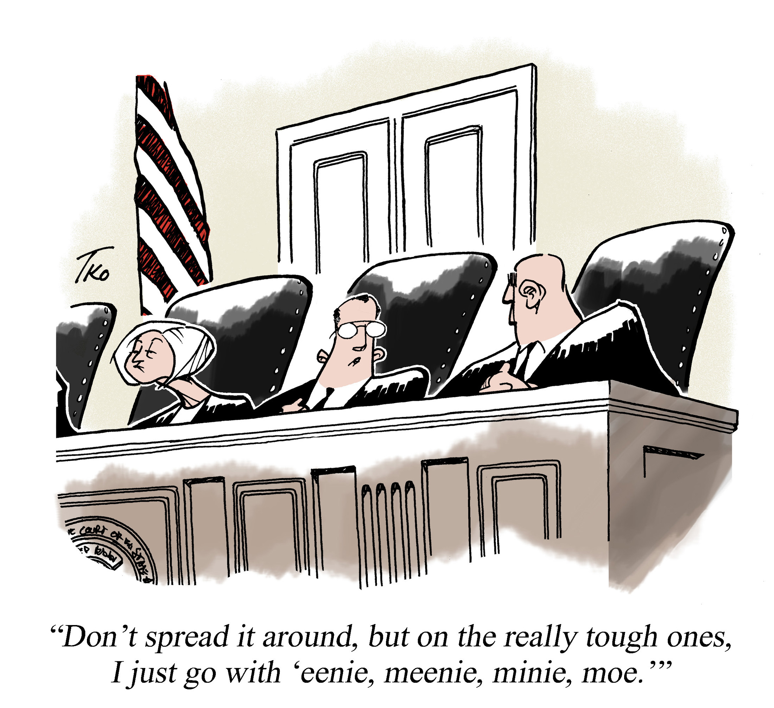

Slide 24
1. Enhanced Roles for States
Opportunity: State-driven approaches to school improvement and accountability
“With the passage of ESSA, states and local districts have an opportunity to put strategies into place that have been proven to be the most successful at increasing student achievement” (Richard DuFour)
Challenge: Will states do the right thing?
“Given the range of state capacity, and states’ different K – 12 priorities, ESSA implementation could look radically different on the ground from one state to the next” (Maria Voles Ferguson, Center on Education policy)
Challenge: Lack of clarity due to change in federal administration and priorities (e.g., mixed feedback on what constitutes “ambitious standards”)

Slide 25
Good News or Not?
“In a thinly disguised rebuke of former secretary of education Arne Duncan, one of the major changes under the law is a reduction of the influence any secretary of education may have on policy. The secretary is expressly prohibited from:
influencing the adoption of any particular standards;
impacting the nature of assessments;
prescribing any aspect of the accountability system;
advocating for specific school supports or improvement strategies; and
prescribing any aspect of educator evaluation systems of measures of effectiveness.
All of these areas are to be left to each state to resolve.” (Richard DuFour, 2017)

Slide 26
Thoughts…?
“The Trump administration is likely to favor maximum flexibility for states to develop plans and set policy under ESSA. The new law is an opportunity, not an inevitability…. To realize the promise of flexibility, states will need to take more seriously their obligations to ensure that students who need the most help--- students of color, foster children, English-language learners, students in poverty, and first-generation students– get the resources and attention they deserve.”
Jack Markell, Democrat, former governor of Delaware and former chair of National Governors Association

Slide 27
2. Equity
Opportunity: Renewed focus on equity and access, defined within the context of each state
“Conversations about equity have dominated our approach to developing our state plan.” (Patrick Halladay, Vermont Agency of Education)
Challenge: Lack of consistency across states
“We have to be really cautious because we know that states have a long track record of not making tough decisions when it comes to the interest of low-income students of color, English-language learners… If states are going to walk away from those students, we are going to lose whatever progress we’ve made (Daria Hall, Education Trust)
Challenge: Reporting on SWDs and diverse populations in rural areas
Challenge: Commitment of current administration
Recent roll-back of ESSA provisions requiring reporting on sub-groups

Slide 28
Equity: Implications & Questions Related to SWDs: Turn and Talk
How will Colorado and its LEAs communicate to stakeholders the importance of SWD being held to same challenging standards as non-disabled peers?
How will the CDE and LEAs work to ensure that necessary conditions for teaching and learning exist, in order to prepare SWDs for success in college, career, and life?
What strategies should be used to ensure ongoing identification and implementation of evidence-based practices to improve achievement and outcomes for SWD?
(adapted from CCSSO document)

Slide 29
3. School Quality and Accountability
Opportunity: Potential to develop comprehensive systems that prioritize school quality and continuous improvement
“We see this as an opportunity to move away from NCLB’s ‘blame and shame’ and ‘good school, bad school’ messages. Instead, our focus is on leveraging ESSA to meet our comprehensive goals around continuous improvement.” (Halladay, VT AOE)
Challenge: Lack of will or capacity at the state and local levels to engage in comprehensive and effective efforts to reform schools
2017 survey by Education Week indicated that only 10% of responding district leaders are sure of how ESSA will change classroom practice in my district.

Slide 30
What might a new era of reform look like?
“In the highest-performing countries, there is a recognition that a school can only be as good as the people within it, and therefore, improvement efforts should be based not on threats but on building the capacity of educators. Furthermore, these countries have consistently turned to the professional learning community process as the key strategy for capacity building (Barber & Mourshed 2009). If states are to pursue this new direction, they will be required to abandon the thinking that led to the failed reforms and embrace a new mindset regarding the most promising strategies to improve their schools.”
Richard Dufour, 2017

Slide 31
Vermont’s Education Quality Standards
Academic Proficiency
Areas assessed under Academic Proficiency are aligned with ESSA requirements
Remaining domains reflect Vermont’s priorities and Education Quality Standards. Schools will be reporting annually on their progress in each of the 5 areas
5 Domains of Education Quality Standards
Personalization
Safe,
Healthy Schools
High Quality Staffing
Investment Priorities
Notes:
Not much needs to be added here. It would be a tangent to get too deep into any of the domains

Slide 32
Vermont’s Education Quality Standards and ESSA
Academic Proficiency
Standards and indicators
Smarter Balanced ELA
Smarter Balanced Math
NGSS Science
PE/Fitness
English Language Proficiency
Graduation Rate
Career and College Ready
Assessments
Outcomes
Notes:
Time: 1-2 minutes
Key Ideas
Many schools do not have significant numbers of English Learners
Review what is the same
Review what is different
Design Logic
Equity- By using the same screening tool we know that students across Vermont will qualify for EL services in the same way regardless of where they go to school
Efficiency- We have used the assessment for a few years, educators are familiar with usage, by being a part of a consortia it is less expensive for us to have a high quality assessment.

Slide 33
Putting the Pieces together (in Vermont)
EDUCATION QUALITY STANDARDS (EQS)
FRAMES
ANNUAL SNAPSHOT
INFORMS
CONTINUOUS IMPROVEMENT PROCESS
INTEGRATED FIELD REVIEWS (IFRs)
PRODUCES
EDUCATION QUALITY REVIEWS (EQRs)
State and federal school and LEA performance data
Collaboratively processing data to identify strengths and recommendations
Provides a policy baseline when identifying data points
Addressing recommendations through action planning
Notes:
Putting the pieces together

Slide 34
Core VALUES IN COLORADO
Colorado’s kids are at the center of decision-making
Equity of opportunity
Improvement for our most challenged schools
Transparency for schools and districts
Flexibility
Practicality
Efficiency

Slide 35
Turn and talk…
What Colorado-specific opportunities and challenges do you identify in relation to school quality, accountability and improvement?
How will federal, state and local entities ensure that the identification and implementation of interventions to promote achievement and outcomes for SWD is supported with the strongest level of evidence and integrated with broader efforts around school improvement and support?
(adapted from CCSSO document)

Slide 36
4. Enhanced and Flexible Assessment Systems
Opportunity: Requirement for states to identify at least one “other indicator” measured at the student level
Challenge: Prioritizing and assessing indicators that have not previously been used
Which measures are ready for use in high stakes accountability?
How will consistency be ensured for newer, more authentic measures?
Where will resources (e.g., time and money) come from to implement new and creative benchmarks?
Will new assessments take into account students with disabilities?
Challenge re-Students with Disabilities: Alternate assessments, Implications of state and local “opt-out” options for parents, extent to which new measures take SWDs into account

Slide 37
Teachers’ Perspectives on “Other Indicators”
Nationally, teachers prefer the following additional measures:
Student social and emotional learning: 23%
Student engagement: 19%
College and/or career readiness: 15%
Student access to and completion of advanced coursework: 5%
Student mindset: 11%
Educator engagement: 8%
School climate and safety: 6%
Other: 13%
(Source: Ed Week survey)

Slide 38
Enhanced Assessment Systems: Implications and Questions for SWD’s
What is the culture in the CDE and across LEAs regarding beliefs about SWD and their participation in state assessments? To what degree is there pressure for SWDs to participate in alternate assessments?
Given requirements for disaggregation, how will “N-sizes” be determined to ensure that results for SWD are communicated and are useful in improving achievement and outcomes for SWD?
Given requirements for UDL in assessment, to what degree are the principles of UDL evident in local practice? (adapted from CCSSO document)

Slide 39
Enhanced Assessment Systems: Implications and Questions for SWD’s (cont’d)
Given ESSA’s allowance of alternate assessment for students with “the most significant cognitive disabilities (with a 1% cap),” how will your state identify these students and coordinate the 1% cap?
What professional learning is needed to address capacity around administration of alternate assessments?
What general strategies will be used to support schools in ensuring that Students with Disabilities make progress toward interim (every 2 – 4 years) and long-term goals (every 6 years)?
(adapted from CCSSO)

Slide 40
Thoughts…how will States and local districts maintain rigor and innovation?
Increased federal intervention under No Child Left Behind was prompted by a lengthy record of states not taking full responsibility for educating all of their students. States must now take advantage of a new opportunity to show that local control doesn’t mean a lowering of the bar for success, but rather more rigor and more innovation with locally designed solutions that support every student.
Jack Markell, Democrat, Governor of Delaware 2009 – 2017, former chair of National Governors Association

Slide 41
5. New Requirements Around Teacher Quality and Evaluation
Opportunity: No more HQT, federal government cannot require states to base teacher evaluation on test scores = Potential to develop teacher talent and evaluate effectiveness in a manner consistent with state context and priorities
Challenge: Developing systems that are consistent and effective
Challenge: Defining “ineffectiveness” and “inexperienced”

Slide 42
Teacher Evaluation Systems Under Consideration
Student learning objectives
Student surveys
Self-reflection
Continued use of student test scores, but with less weighting
No changes from approaches used in waivers

Slide 43
6. Workforce Development
Opportunity: States have more leeway in use of Title II funds for teacher and leadership development; may be seen as helpful in addressing shortages
Challenge: New opportunities under Title II raise concerns about quality of market-based and alternative routes to licensure
Teacher and Leader Academies allowed, may be independent of higher education
Year-long residencies with mentors as a route to licensure
Challenge: New calculations for Title II grants, weighted for poverty. Some states (CA, FL, GA, NC, TN, TX) could receive 10 million more annually; Others (IL, MA, MI, NY, PA and Puerto Rico) could receive $10 million less than in FY16

Slide 44
Workforce Development: Implications and Questions Related to SWDs
How will increased flexibility within Title II allow Colorado to attract, prepare, develop and retain teachers of students with disabilities?
How might additional flexibility within Title II be used to increase the capacity of school leaders to support the needs of students with disabilities?
How will the CDE support LEAs in delivering high quality professional development for teachers, principals, and other school leaders to support students with disabilities?
(adapted from CCSSO document)

Slide 45
Other “Elephants in the Room”
Affordable Care Act and Potential Changes to Medicaid
Cuts of 800 Million?
Secretary’s Focus on Increased Choice and Privatization of Schools
Impacts on rural schools
The Federal Budget
Cuts of 13.5% (9,2 billion) to Ed.?

Slide 47
ESSA and You: Leaders as Policy Implementers, Actors & Advocates
What do we know about implementation from research on policy implementation, implementation science, and improvement science?
What’s your role in implementation and improvement?
What aspects of ESSA are of greatest interest and concern to you and the students, families, teachers and schools you serve?
What kinds of advocacy will you engage in?

Slide 48
practice
policy
research

Slide 49
ESSA as Policy Implementation: Research 1960 - 1990
Wave 1: Research focused on what gets implemented
Early studies of ESEA identified implementation failure, attributed to a lack of capacity and will (Odden, 1991; Elmore & McLaughlin, 1988)
Wave 2: Research attended to what is implemented over time
Continued focus on fidelity of implementation, but more recognition of variations in implementation (Kirst & Jung, 1980)
Emerging focus on the importance of actors and “street level bureaucrats” (Weathersly & Lipsky, 1977)
Implementation as “mutual adaptation” between macrolevel demands and microlevel context (Berman & McLaughlin)

Slide 50
Policy Implementation Research, continued
Wave 3: Growing concerns over “What Works”
Full implementation = demonstrable improvement for students
New attention to curriculum and instruction/teachers’ roles (McLaughlin, 1990), as well as leaders of LEAs and SEAs
Importance of policy design and “policy instruments” (McDonnell & Elmore)
Importance of the conditions of implementation (McLaughlin, 1991)

Slide 51
Contemporary Views-Policy Design & Implementation
Current views highlight complexity of change (Honig, 2006)
Policy design focused on large-scale change initiatives and high standards for all students
Policy research recognizes multiple actors, including people/organizations at local, state, and federal levels; families, communities, and agencies
New tools of policy go beyond mandates and sanctions: include capacity building, systems change, professional learning
Implementers of change “now juggle an arguably unprecedented number of strategies, logics, and underlying assumptions about how to improve school performance” (Hatch,2002, as cited by Honig, 2006)

Slide 52
Honig’s People, Places and Policies Framework
Formal & informal targets
Communities and other associations
Policy makers as key implementers
People
Goals
Targets
Tools
Historical / institutional context
Cross-system interdependencies
Policies
Places

Slide 53
ESSA and Implementation Science
Implementation “Is synonymous with coordinated change at system, organization, program, and practice levels” (Fixsen et al., 2005).
Implementation science addresses the gap between the theory and science of effective practices and what is actually done in policy and practice.
Implementation is most successful when:
Organizations provide necessary infrastructure for training, supervision and coaching, and regular evaluations
Consumers and communities are involved in selecting programs and practices
State and federal funding, policies and regulations create a hospitable environment for implementation

Slide 54
ESSA and Continuous Improvement: Reducing the Gap Between What is Actual and What is Possible
Six Core Principles of Improvement (Carnegie Foundation)
Make the work problem-specific and user-centered.
Variation in performance is the core problem to address (What works for whom and under what conditions).
See the system that produces the current outcomes.
We cannot improve at scale what we cannot measure.
Accelerate improvements through networked communities.
Anchor practice improvement in disciplined inquiry.

Slide 55
Common Elements of Improvement Organizations (Park, Hironaka, Carver & Nordstrum, 2013)
Leadership: Leaders set the agenda, create conditions and monitor progress
Communication and engagement: Stakeholders engage in systems-thinking, act on a collective vision, and develop shared accountability
Organizational infrastructure: Structures are established across core processes or around specific goals
Methodology: Organizations use specific approaches (e.g., inquiry cycle, analysis of student data, etc.) to guide change
Data collection and analysis: Data track progress towards goals
Capacity building: Investing time / energy into training and supporting staff

Slide 56
Implementation Takeaways: Key Questions for Leaders
What does the interaction of people, place, and policy (ESSA) look like in your context?
What aspects of ESSA and Colorado’s State Plan might be viewed as part of a larger focus on school improvement?
Who will be involved in setting local goals, establishing processes for inquiry and improvement, collecting data, and monitoring progress? What roles have you or might you play in this process?

Slide 57
ADVOCACY

Slide 58
ESSA Implementation as a Form of Advocacy: What Do You Care About?
Critical Issues for SEAs, LEAs – and You!
Addressing challenges to equity
Enhancing academic proficiency and “whole child” outcomes for all
Focusing on college and career readiness
Ensuring high quality teacher preparation and a diverse workforce
Ensuring meaningful teacher evaluation
Ensuring that the needs of students with disabilities are considered in all aspects of planning and implementation
Attending to contextual issues (rural schools, demographics, etc.)

Slide 59
The Disconnect Between Research and Policy (McLaughlin et al., 2016; p. 7)

Slide 60
Considerations in Advocacy
Recognize:
“Disconnects” between policy, research and scholarship, and professional knowledge
Mismatch between the cultures of PK- 12 education, higher education, and policy making bodies
The role of social media in policy making

Slide 61
Take Action: Federal Level
Contact your Congressional delegates
Engage with CEC’s Legislative Action Center (LAC) website: Go to: cec.sped.org
Look under “Policy and Advocacy” and “Take Action”
cqrcengage.com
AACTE Action Alerts: Look up under AACTE.org
Hold lawmakers accountable!

Slide 62
Take Action: State Level
Get to know your state plan; leverage your expertise
Stay abreast of/ make your voice heard in new developments (e.g., development of new “other indicator”– projected for June, 2018)
Contact your state legislators
Participate in state level trainings on ESSA
Engage others: Paras, local civil rights leaders, etc.

Slide 63
Take Action as professionals
Higher Education Consortium on Special Education (HECSE) supports:
Reforms that ensure effective preparation of all educators
Common metrics for determining whether or not special educators are “profession-ready”
State licensing and credentialing systems that maintain rigorous standards for new teachers
Ongoing systems of support for newly inducted teachers
High standards for all teachers, throughout their careers
Research on effective preparation of teachers and leaders
Funding for research, personnel preparation, Part D of IDEA

Slide 64
Lessons for Living in Interesting Times
1. “Don’t rehearse your nightmares.”
Larry Wexler, U.S. Dept. of Education

Slide 65
Lessons…
2. Hold on tight for the ride.

Slide 66
Lessons…
3. Stay true to what matters most to you.

Slide 67
Lessons
4. Remain open to the opportunities around you.

Slide 68
Lessons
5. Engage in collaboration
Draw on the shared expertise, creativity and strengths of your colleagues and partners, including community, state, and
higher education partners!

Slide 69
Sources
Overview of ESSA
ESSA’s Impact: Views from Districts and Schools. (2017). Webinar from Ed Week. Edweek.org/go/webinars.
ESSA: Key Provisions and Implications for Students with Disabilities http://www.ccsso.org/Documents/2016/ESSA/ESSA_Key_Provisions_Implications_for_SWD.pdf
Inside ESSA: The New Federal K-12 Law. (January, 6, 2016). Series of articles published by Education Week, available for viewing at edweek.org.
National Conference of State Legislatures (n.d.). Summary of the Every Student Succeeds Act, legislation reauthorizing the Elementary and Secondary Education Act. Author.

Slide 70
Sources
ESSA and School Improvement
Carnegie Foundation for the Advancement of Teaching (2017). Using implementation science to accelerate learning and address problems of practice. Author.
CCSSO. http://chiefsforchange.org/wp-content/uploads/2016/05/School-Improvement-Strategies-Under-ESSA.pd
Darling-Hammond, L., Hyler, M. E., Gardner, M. (2017).Effective Teacher Professional Development . Palo Alto, CA: Learning Policy Institute. https://learningpolicyinstitute.org/product/teacher-prof-dev
DuFour, R. (2016). PLC at Work: ESSA, An Opportunity for American Education. Solution Tree.
Fixsen, D.L., Naoom, S.F., Blase, K.M. Firedman, R.M., & Wallace, F. (2005). Implementation research: A synthesis of the literature. Tampa, FL: University of South Florida.

Slide 71
Sources
Fixsen, D.L., Naoom, S.F., Blase, K.M. Firedman, R.M., & Wallace, F. (2005). Implementation research: A synthesis of the literature. Tampa, FL: University of South Florida.
History of federal education legislation
http://socialwelfare.library.vcu.edu/programs/education/elementary-and-secondary-education-act-of-1965/
Policy Implementation
Honig, M.I. (2006). Complexity and policy implementation: Challenges and opportunities for the field. In M. I. Honig, New directions in policy implementation: Confronting complexity. Albany, NY: State University of New York Press

Slide 72
Katharine G. Shepherd Ed.D Associate Dean - Green & Gold Professor College of Education & Social Services University of Vermont 308 Waterman Bldg., Burlington VT 05405 V 802.656.1348
Thank you!

